Slide 1

PROGRAMME 2
COMPLEX NUMBERS 2

Slide 2
Polar-form calculations
Roots of a complex number
Expansions
Loci problems

Slide 3
Polar-form calculations
Roots of a complex number
Expansions
Loci problems

Slide 4
Polar-form calculations
Notation
Positive angles
Negative angles
Multiplication
Division

Slide 5
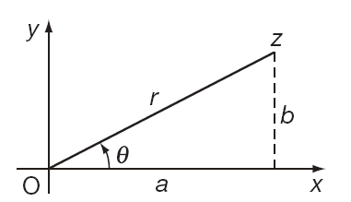




Polar-form calculations
Notation
The polar form of a complex number is readily obtained from the Argand diagram of the number in Cartesian form.
Given:
then:
and
The length r is called the modulus of the complex number and the angle is called the argument of the complex number

Slide 6

Polar-form calculations
Positive angles
The shorthand notation for a positive angle (anti-clockwise rotation) is given as, for example:
With the modulus outside the bracket and the angle inside the bracket.

Slide 7

Polar-form calculations
Negative angles
The shorthand notation for a negative angle (clockwise rotation) is given as, for example:
With the modulus outside the bracket and the angle inside the bracket.

Slide 8
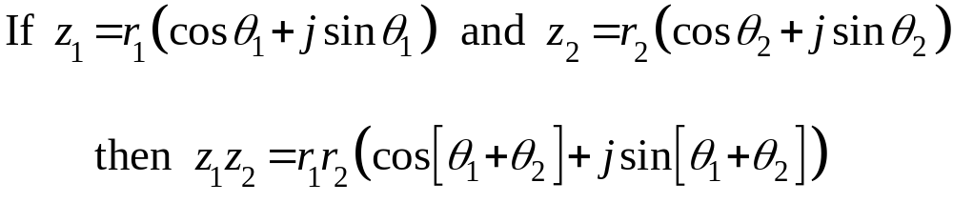
Polar-form calculations
Multiplication
When two complex numbers, written in polar form, are multiplied the product is given as a complex number whose modulus is the product of the two moduli and whose argument is the sum of the two arguments.

Slide 9
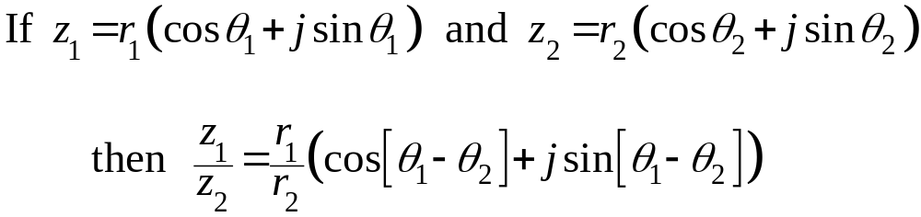
Polar-form calculations
Division
When two complex numbers, written in polar form, are divided the quotient is given as a complex number whose modulus is the quotient of the two moduli and whose argument is the difference of the two arguments.

Slide 10
Polar-form calculations
Roots of a complex number
Expansions
Loci problems

Slide 11
Polar-form calculations
Roots of a complex number
Expansions
Loci problems

Slide 12
Roots of a complex number
De Moivre’s theorem
nth roots

Slide 13
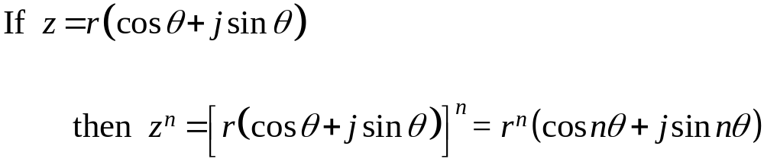
Roots of a complex number
De Moivre’s theorem
If a complex number is raised to the power n the result is a complex number whose modulus is the original modulus raised to the power n and whose argument is the original argument multiplied by n.

Slide 14
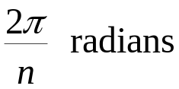
Roots of a complex number
nth roots
There are n distinct values of the nth roots of a complex number z. Each root has the same modulus and is separated from its neighbouring root by

Slide 15
Polar-form calculations
Roots of a complex number
Expansions
Loci problems

Slide 16
Polar-form calculations
Roots of a complex number
Expansions
Loci problems

Slide 17

Expansions
Trigonometric expansions
Since:
then by expanding the left-hand side by the binomial theorem we can find expressions for:

Slide 18
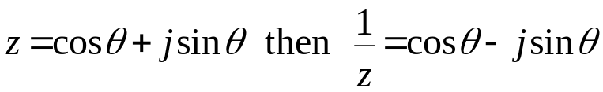
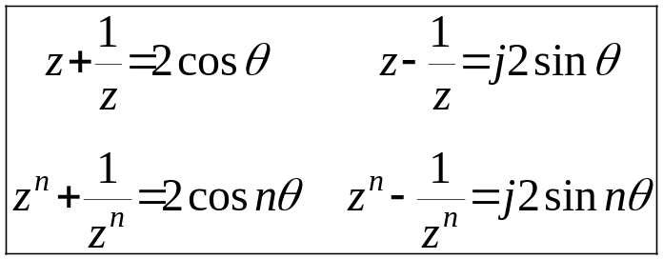
Expansions
Trigonometric expansions
Let:
so that:

Slide 19
Polar-form calculations
Roots of a complex number
Expansions
Loci problems

Slide 20
Polar-form calculations
Roots of a complex number
Expansions
Loci problems

Slide 21
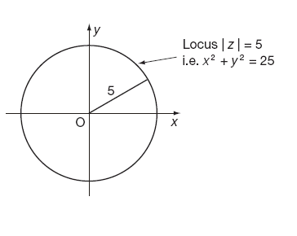

Loci problems
The locus of a point in the Argand diagram is the curve that a complex number is constrained to lie on by virtue of some imposed condition.
That condition will be imposed on either the modulus of the complex number or its argument.
For example, the locus of z constrained by the condition that is a circle

Slide 22
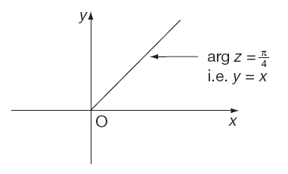
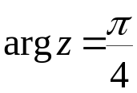
Loci problems
The locus of z constrained by the condition that
is a straight line

Slide 23
Learning outcomes
Use the shorthand form for a complex number in polar form
Write complex numbers in polar form using negative angles
Multiply and divide complex numbers in polar form
Use de Moivre’s theorem
Find the roots of a complex number
Demonstrate trigonometric identities of multiple angles using complex numbers
Solve loci problems using complex numbers

